Slide 1
Universitäres Institut akkreditiert nach HFKG
Institut universitaire accrédité selon la LEHE
Diagnosing 3S
Notes:
Recent paper
Not discuss everything. Mostly important for the question raised and idea of future directions and projects.

Slide 2
Methods

Slide 3
Line intersections
2
5
Rationale: Synesthetic forms should have less line intersections. This is due to a coherent form.
4
1
3
i.e. 3 crossings:
1-2 & 3-4
1-2 & 4-5
2-3 & 4-5

Slide 4
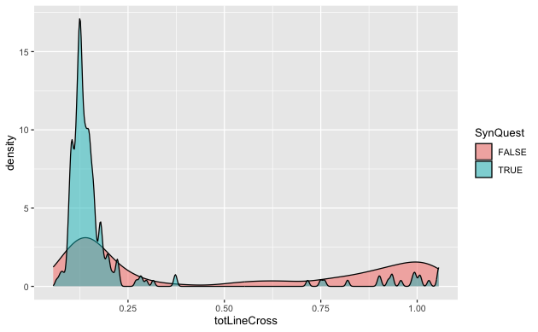
“Line intersection” criteria
Notes:
Distributions should differ in median, not overlap. See with NR about different criteria to cutoff the questionnaire Monday.

Slide 5
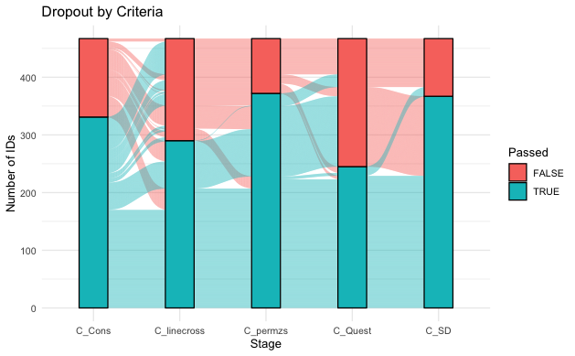
Comparing criteria
Only Ward Data

Slide 6
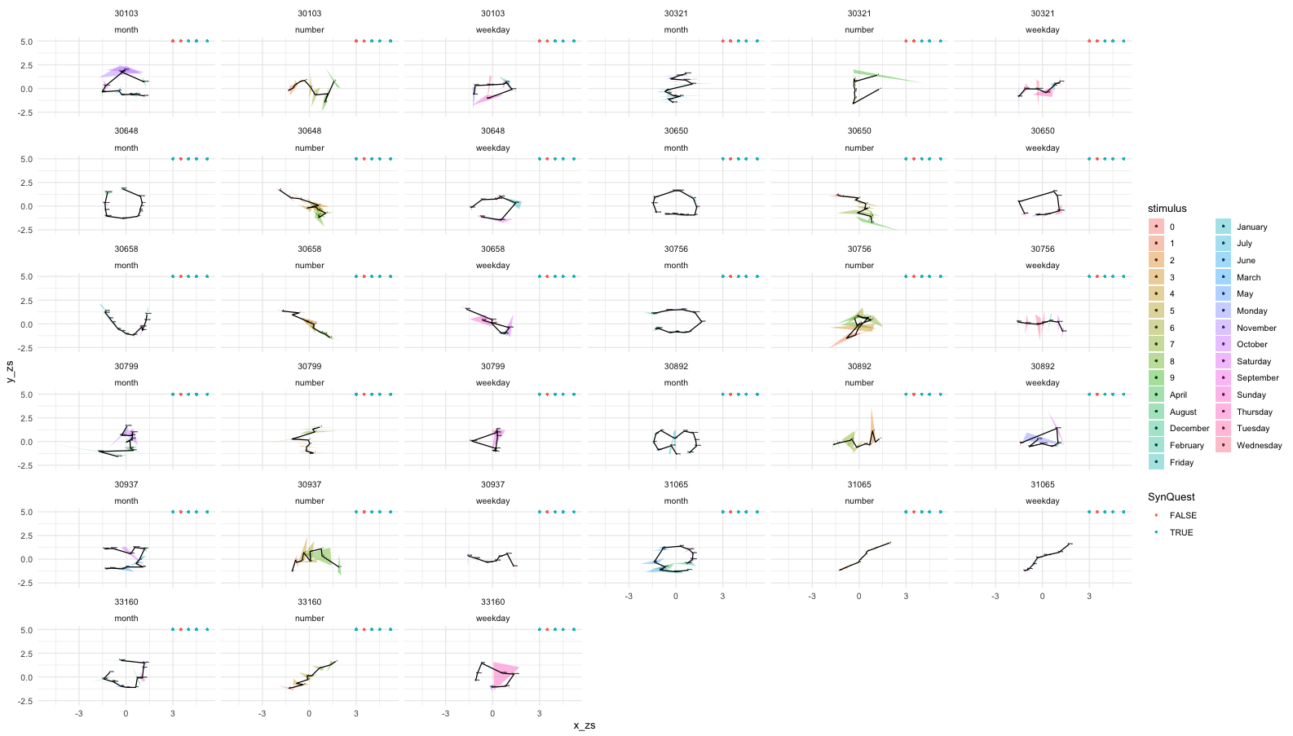
Inconsistent but pass Line

Slide 7
Question
How to compare criteria?
Add other data?
How to set cutoffs?

Slide 8
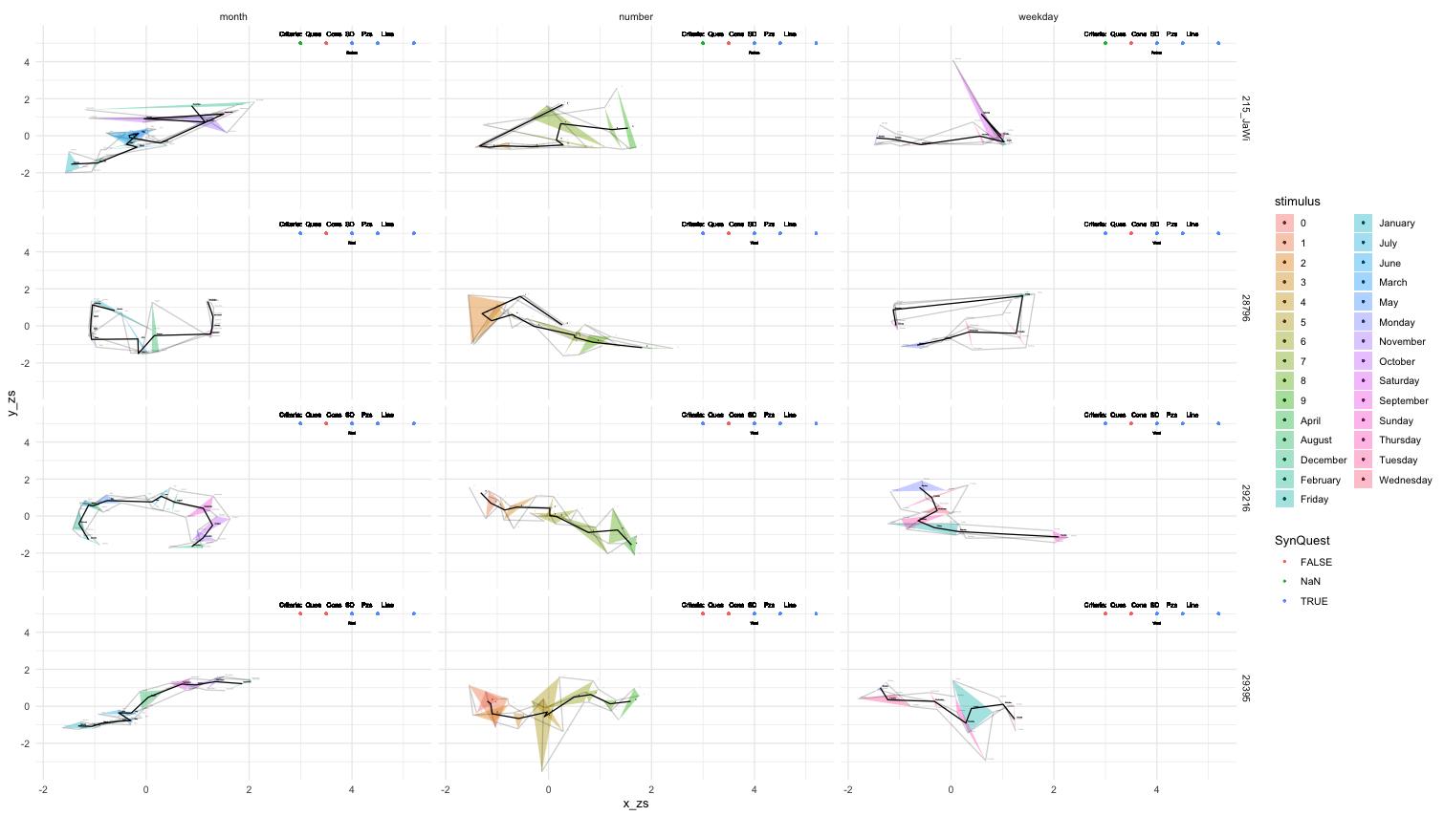
I.e. Inconsistent area, consistent line.

Slide 10
Discussion with NR
Questionnaire
Q1 . Some people routinely think about sequences as arranged in a particular spatial configuration (as in the examples below), do you think this might apply to you? (1=strongly agree, 5= strongly disagree) | Q2_numbers (1=present, 0=absent) | Q2_days (1=present, 0=absent) | Q2_months (1=present, 0=absent) | Q2_years (1=present, 0=absent) | Q2_letters (1=present, 0=absent) | Q2_temperature (1=present, 0=absent) | Q2_height (1=present, 0=absent) | Q2_weight (1=present, 0=absent) | Q3 Where do you tend to routinely experience these sequences? (1= in the space outside my body; 2= on an imagined space that has no real location; 3= inside my body; 4= this doesn't apply to me!)
Q4_colours (1=present, 0=absent) | Q4_shading (1=present, 0=absent) | Q4_2D (1=present, 0=absent) | Q4_3D (1=present, 0=absent) | Q4_perspective (1=present, 0=absent) | Q4-blocks-or-tiles (1=present, 0=absent) | Q4_font (1=present, 0=absent)
Q5 Before doing this experiment, I always thought about NUMBERS as existing in a particular spatial sequence (1= strongly agree; 5= strongly disagree) | Q6 Before doing this experiment, I always thought about DAYS OF THE WEEK as existing in a particular spatial sequence (1= strongly agree; 5= strongly disagree) | Q7 Before doing this experiment, I always thought about MONTHS OF THE YEAR as existing in a particular spatial sequence (1= strongly agree; 5= strongly disagree) | Q8 I use this way of thinking about spatial sequences in my everyday life (1= strongly agree; 2= strongly disagree) | Q9 When doing the experiment, I didn't have any strong intuition as to where to put the NUMBERS (1= strongly agree; 5= strongly disagree) | Q10 When doing the experiment, I didn't have any strong intuition as to where to put the DAYS OF THE WEEK (1= strongly agree; 5= strongly disagree) | Q11 When doing the experiment, I didn't have any strong intuition as to where to put the MONTHS OF THE YEAR (1= strongly agree; 5= strongly disagree) | Q12 This experiment didn't really make much sense to me (1= strongly agree, 5= strongly disagree) | Q13 Feel free to enter any comments here. E.g. what strategy did you use? Do you want to clarify any of the above answers?

Slide 11
Vielen Dank für Ihre Aufmerksamkeit! Merci pour votre attention ! Thank you for your attention!
Universitäres Institut akkreditiert nach HFKG
Institut universitaire accrédité selon la LEHE

